Slide 1
Input New Location:
Latitude
Longitude
Date-time
Start here
Hour Changed?
NO
Append(Latitude, Longitude, Date-time) -> Current_Hour_Points
YES
Calculate Stay-points: in Current_Hour_Points
Add time between stay-points based on speed
Group stay-points to form states (Using DB to snap the stay-points)
States
Calculate Markov Chain Model on States
Calculate Hourly State Weights (time-slotted data)
Calculate transition matrix for the day passed.
NO
Date Changed?
YES

Slide 2
Hour t
4 5 6 7 8 9 10 11
Location Coordinates
Stay-points
sp₁ | sp₂ | …
States
st₁ | st₂ | …
Hour t
5 6 7 8 9 10 11
Time-slotted data
st₁, st₂ |  |  |  | st₂ | st₂
Markov Chain
… | …
mc₄ | mc₅ | mc₆ | mc₇ | mc₈ | mc₉ | mc₁₀ | mc₁₁ | mc₁₂ | mc₁₃
… | …

Slide 3
p4
p1
p3
st₁
st₂
p2
p4
p1
p3
st₁
st₂
p2
p5
p6
st₃
p4
p7
p8

Slide 4

home
home
Missing location data
18:00
06:00
hour
x = 0 Kms
t = 12 hours
Day 1
Day 2

Slide 5

home
work
Missing location data
7:00
8:00
hour
x = 6 Kms
t = 1 hour

Slide 6
GPS Trajectory Points
Markov Model
Stay-points Detection
Next Location Prediction
State Transitions
State Formation
Time-slotted States

Slide 7



Slide 8
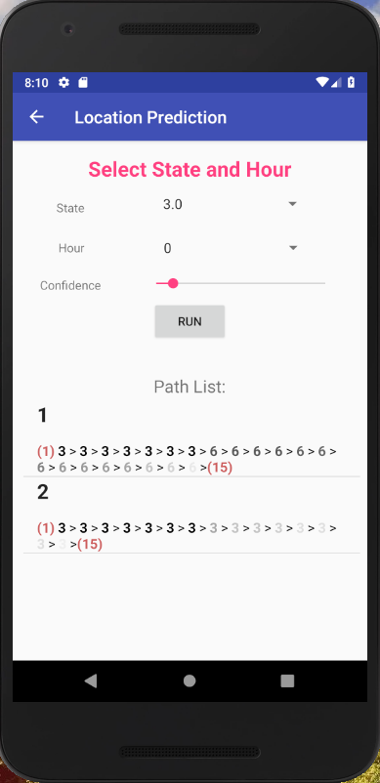


Slide 9
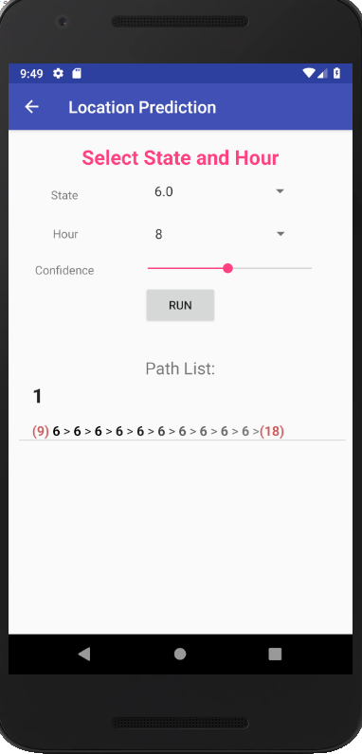
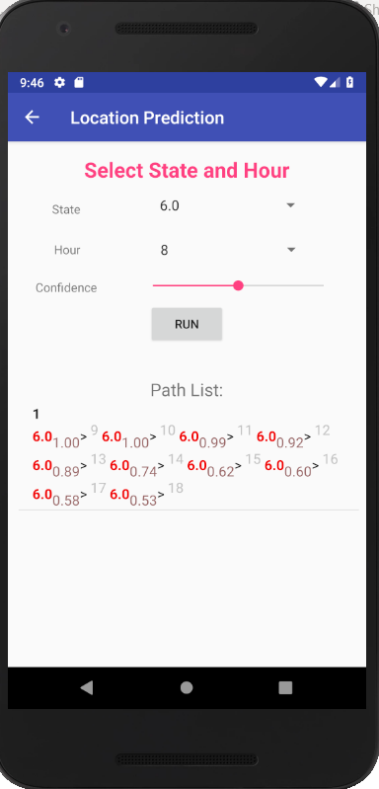

Slide 10
Hour t
4 5 6 7 8 9 10 11
st₁
st₂
st₃
Hour t
4 5 6 7 8 9 10 11
st₁
st₂
st₃
st₁ = 10/60
st₂ = 35/60
st₁ = 60/60

Slide 11
0.78
0.22
0
st₁
st₂
0
Hour t
4 5 6 7 8 9 10 11
st₁
st₂
st₃
st₁ = 0.22
st₂ = 0.78
st₁ = 1

Slide 12
Snapping same stay-points to form states
Hour t
4 5 6 7 8 9 10 11
STAYPOINTS
SP1
SP2
SP3
SP4
STAYPOINTS
Hour t
4 5 6 7 8 9 10 11
STATES
ST1
ST2
ST1
ST2
STATES
Hour t
4 5 6 7 8 9 10 11
STATE WEIGHTS
W_{ST1}=
0.6667
W_{ST2}=
0.6667
W_{ST2}=
0.9167
W_{ST1}=
0.6667
W_{ST1}=
0.4167
W_{ST2}=
0.4167
W_{ST2}=1
W_{ST2}=0.333
STATE WEIGHTS

Slide 13
Location Coordinates
Snapping same stay-points to form states
Hour t
4 5 6 7 8 9 10 11
STAYPOINTS
STAYPOINTS
Stay-points
Hour t
4 5 6 7 8 9 10 11
STATES
st₁
st₁
STATES
States

Slide 14
State hourly weight
Hour t
4 5 6 7 8 9 10 11
STATE WEIGHTS
W={
0.67}
W={
0.92}
W={0.42}
W={0.33}
STATE WEIGHTS
Hour t
4 5 6 7 8 9 10 11
N-STATE WEIGHTS
W={1}
W={1}
W={1}
W={1}
N-STATE WEIGHTS
Normalized State hourly weight

Slide 15
t=5
st₁ st₂
t=5
st₁ st₂
0.33 | 0.67
0 | 0
0.33 | 0.67
0.5 | 0.5
st₁ st₂
st₁ st₂
1
t=5
st₁ st₂ st₃
2
t=5
st₁ st₂ st₃
3
t=5
st₁ st₂ st₃
0.33 | 0.67 | 0
0.33 | 0.67 | 0.00001
0.3299 | 0.6699 | 9.99x10⁻⁶
st₁
State transition weights
st₁
State transition weights
with 0 replaced with small weight
st₁
Transition probabilities

Slide 16
STAYPOINTS
Hour t
4 5 6
60 min
20 min
40 min
STATES
STATE
st₁
st₁
st₂
STATE
Hour t
4 5 6
STATE WEIGHTS
W_{ST1}=
1
W_{ST1}=
0.33
W_{ST2}=
0.67
STATE WEIGHTS

Slide 17
State Hourly Weights
…
W_{ST1(4)} = (04:45 - 04:05).minutes/60 = 40/60 = 0.6667
W_{ST2(4)} = 0
W_{ST1(5)} = 0
W_{ST2(5)} = (06:00 - 05:20).minutes/60 = 40/60 = 0.6667
W_{ST1(6)} = 0
W_{ST2(6)} = (06:55 – 06:00).minutes/60 = 55/60 = 0.9167
W_{ST1(7)} = (08:00 – 07:20).minutes/60 = 40/60 = 0.6667
W_{ST2(7)} = 0
W_{ST1(8)} = (08:25 – 08:00).minutes/60 = 25/60 = 0.4167
W_{ST2(8)} = (09:00 – 08:35).minutes/60 = 25/60 = 0.4167
W_{ST1(9)} = 0
W_{ST2(9)} = (10:00 – 09:00).minutes/60 = 60/60 = 1
W_{ST1(10)} = 0
W_{ST2(10)} = (10:20 - 10:00).minutes/60 = 20/60 = 0.3333
…

Slide 18
Hourly Matrix
STATES-> ST1 ST2
t₄ = [ 0.6667 0 ]
t₅ = [ 0 0.6667 ]
t₆ = [ 0 0.9167 ]
t₇ = [ 0.6667 0 ]
t₈ = [ 0.4167 0.4167 ]
t₉ = [ 0 1 ]
t₁₀ = [ 0 0.3333 ]
ST1
ST2
ST1 | ST2
0.6667
0
t₄₋₅=
0 | 0.6667
ST1 | ST2
ST1
ST2
0 | 0.4445
0 | 0
t₄₋₅=
Markov Chain t₄₋₅
0.4445
0
0
ST1
ST2
0

Slide 19


Slide 20
th_d
state st_{i}
new stay-point sp_{j}
state st_{i} new mean
state st_{i} current mean

Slide 21
th_d
th_d
stay-point “home”
stay-point “home” mean
new stay-point “work”
stay-point “work’ mean
travelling from “home” to “work”

Slide 22
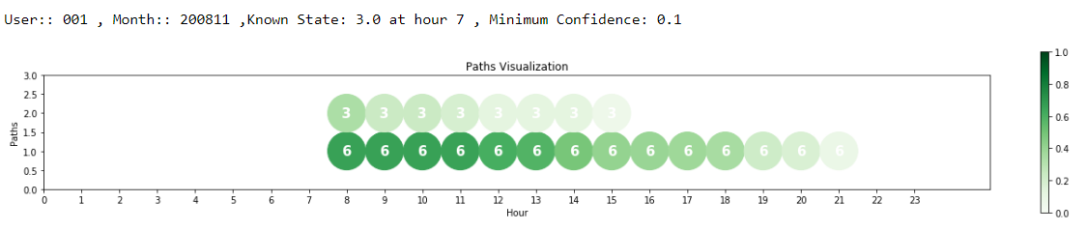
“work”
“home”
Confidence

Slide 23
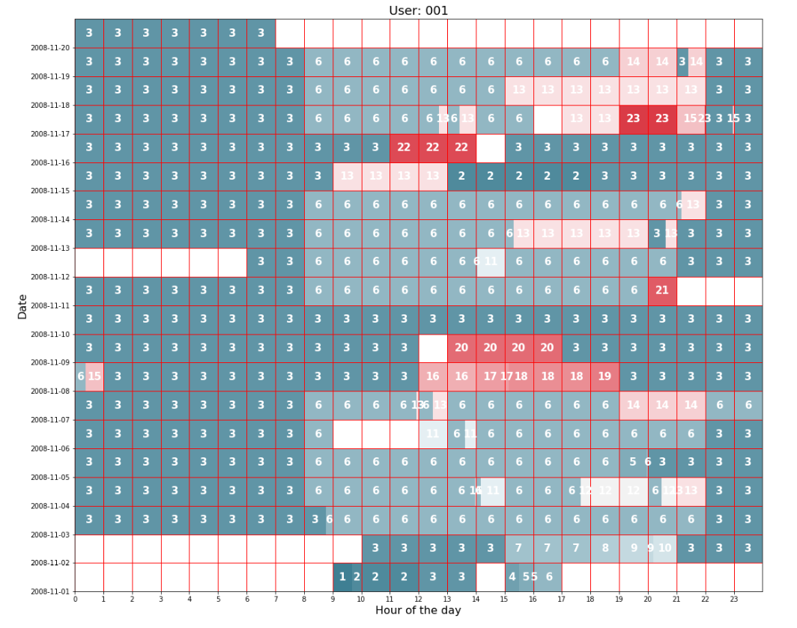

Slide 24
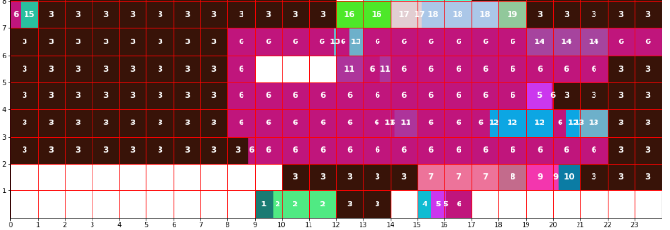
Day
Hour

Slide 25
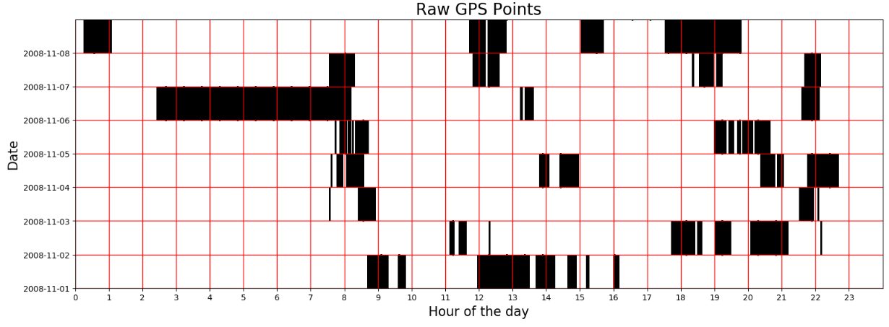

Slide 26
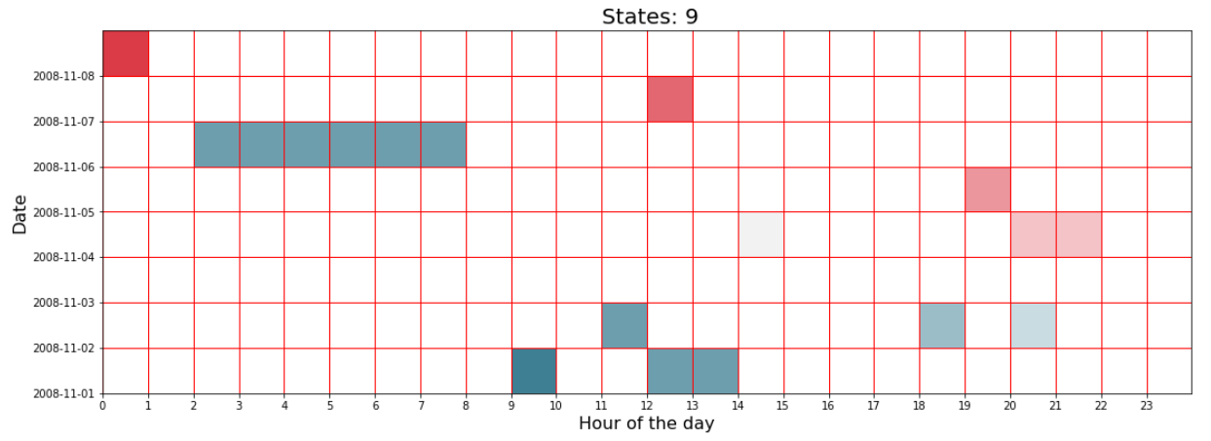

Slide 27
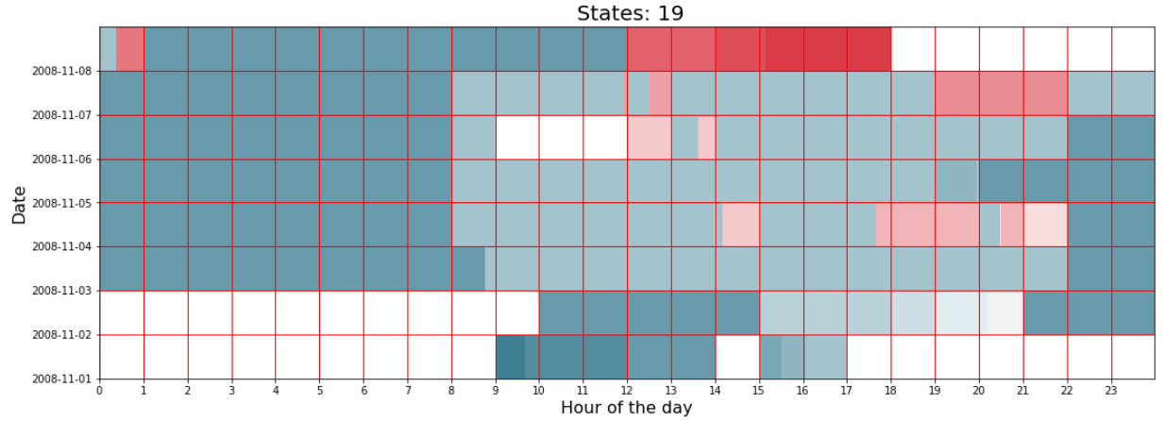

Slide 28
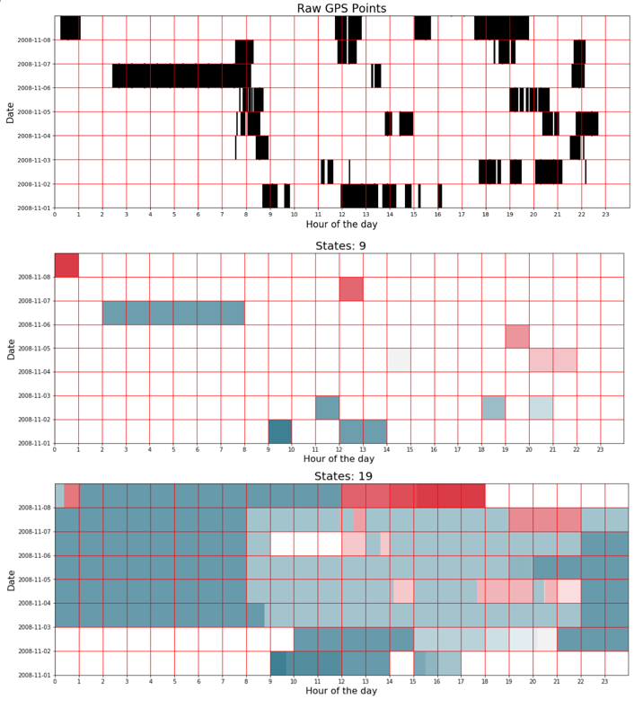

Slide 29
Correct Prediction
Incorrect Prediction
Neither Correct, Nor Incorrect
Prediction
Predicted transition
Predicted transition
Predicted transition
5 6 7
5 6 7
Hour t
5 6 7
st₁
st₂
st₃
st₁
st₂
st₁
st₂
Training
Training
Hour t
5 6 7
5 6 7
5 6 7
Test
st₁
st₂
st₁
st₁
st₁
Test
Actual transition
Actual transition

Slide 30
Prediction Made
Prediction Not Made
Predicted transition
Predicted transition
5 6 7
5 6 7
Hour t
Training
st₁
st_{n}
st₁
st_{n}
Training
Hour t
5 6 7
5 6 7
Test
st₁
st_{k}
st_{new}
st_{k}
Test
Actual transition
Actual transition

Slide 31
t
1
P =
p₁ p₂ p₃ p₄ p₅
t
2
newP =
max(p₁-mlf,0) max(p₂-mlf,0) max(p₃-mlf,0) max(p₄-mlf,0) max(p₅-mlf,0)
max(p₁-mlf,0) / sum(newP) max(p₂-mlf,0) / sum(newP)
max(p₃-mlf,0) / sum(newP)
max(p₄-mlf,0) / sum(newP)
max(p₅-mlf,0) / sum(newP)
3
normP =

Slide 32
mlf = 0.05
1
P =
0.79 0.12 0.03 0.03 0.03
2
newP =
0.74 0.07 0 0 0
3
normP =
0.91 0.08642 0 0 0

Slide 33
st = {st₁, st₂, …st_{n}}
sp = {sp_{1,} sp₂, … sp_{n}}
w = {w₁, w_{2, …} w_{k}}

Slide 34
